Slide 1
Rating-Web Website
Prepared by group 8
Team leader: Seyit Ahmet Inci
Team members:
Sinem imge Turgut.
Abraham Henry Atogwe.
Khawlah Alshubati

Slide 2
Project Topic : _{RatingWeb}
The aim of the WebRating System is to help users identify the genuineness of the websites they are using and to know which website is better by the opinion of other users.
1

Slide 3
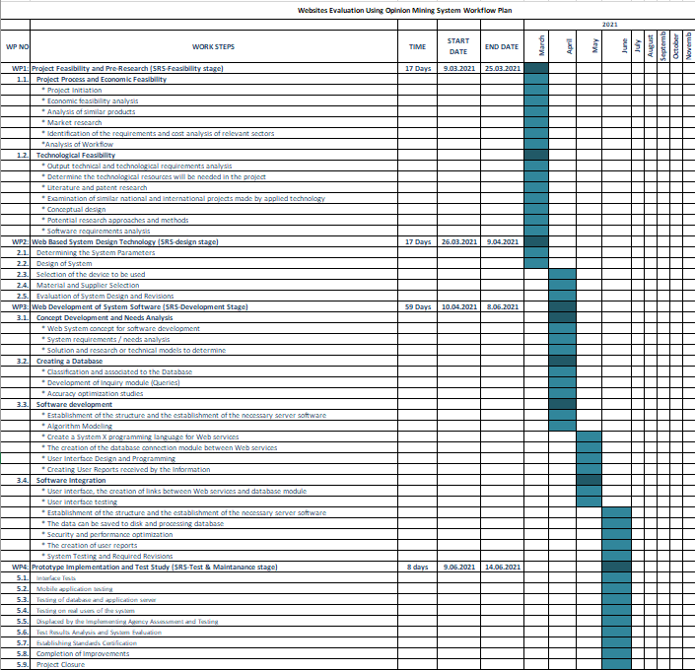
Gannt Chart:
2

Slide 4
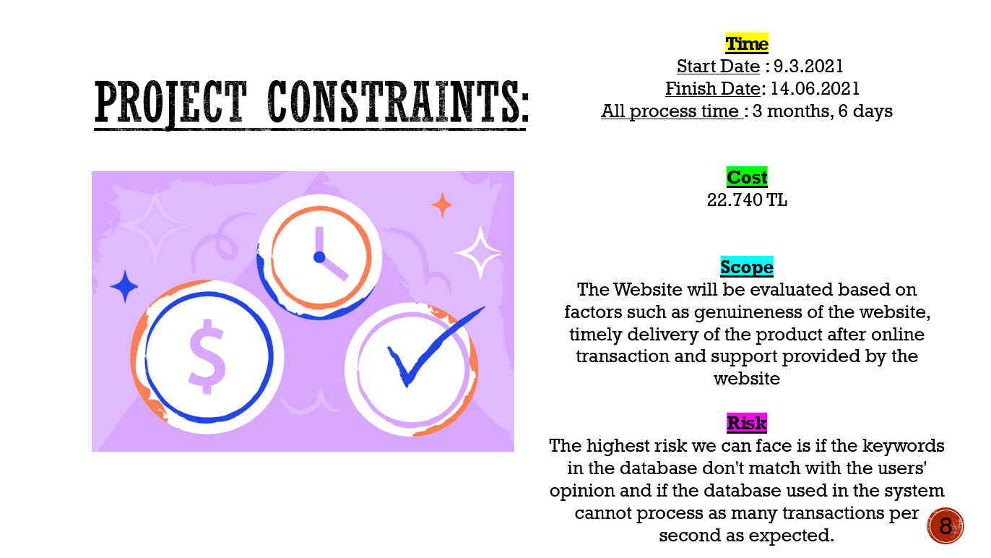

8

Slide 5
Project Ethics:
The Ratingweb website acts consistently with the public interest.
RatingWeb ensures that their products and related modifications meet the highest professional standards possible.
RatingWeb managers and leaders shall subscribe to and promote an ethical approach to the management of software development and maintenance.
RatingWeb colleagues shall be fair to and supportive of their colleagues.
4

Slide 6
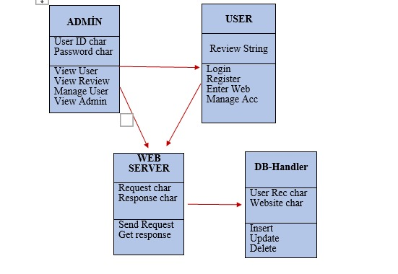
Class Diagram:
5

Slide 7
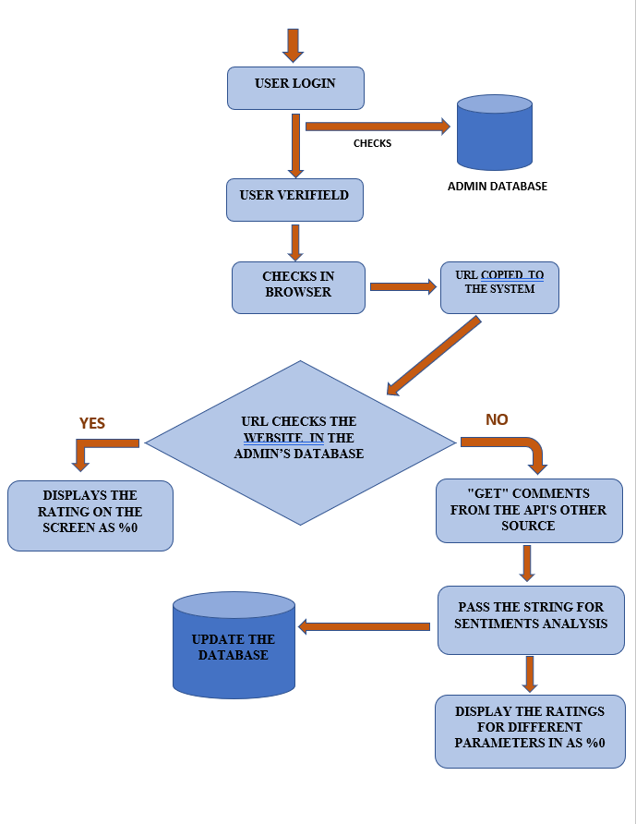
Activity flowchart Diagram:
6

Slide 8
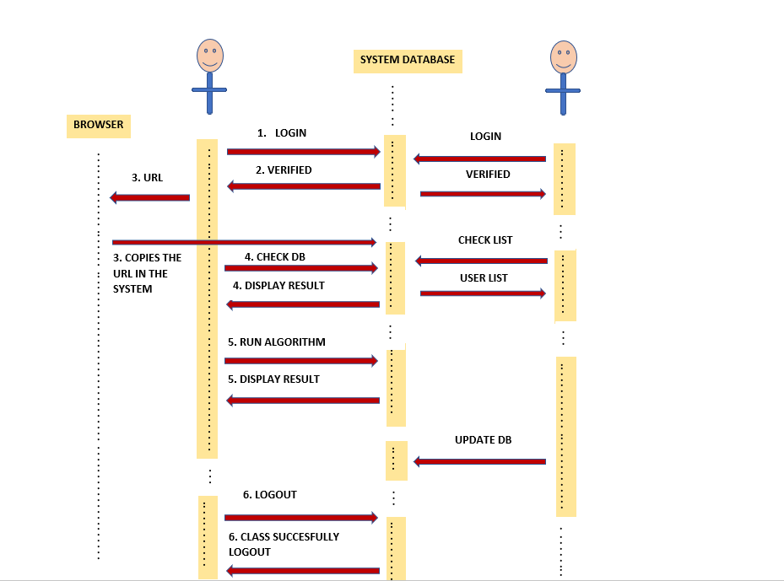
Sequence diagram:
7

Slide 9
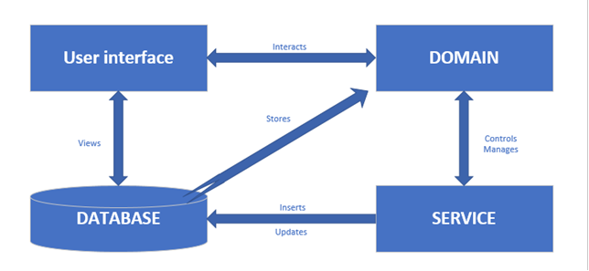
Analysis Diagram:
8

Slide 10
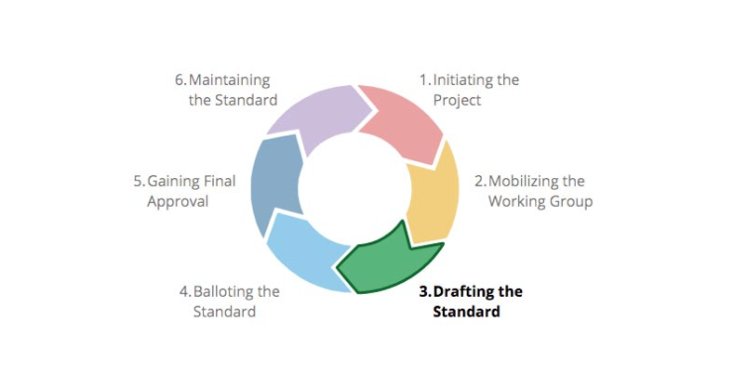
Standards Applied:
IEEE Standards
9

Slide 11
Functional Requirements:
The user should be able to navigate between the tabs of different websites.
The user should be able to login and logout of the system.
The user should have either used the website before or is looking to use a certain website.
The user should be able to navigate between the tabs of different websites.
The user should be able to login and logout of the system.
The user should have either used the website before or is looking to use a certain website.
The user needs to be honest and biased when giving his opinion.
The admin should have to be in contact with the website’s owner.
The admin needs to be aware of all new created websites so as to add them to the system to be rated.
The admin should be able to add and describe the website.
The admin should focus more on the websites that prompts the user to transfer money or do
payments since such websites have the biggest priority for rating.
10

Slide 12
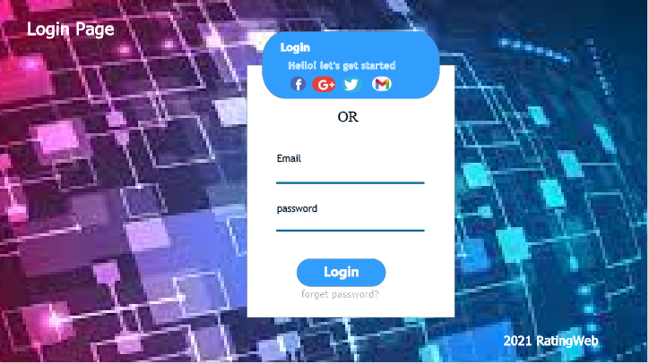
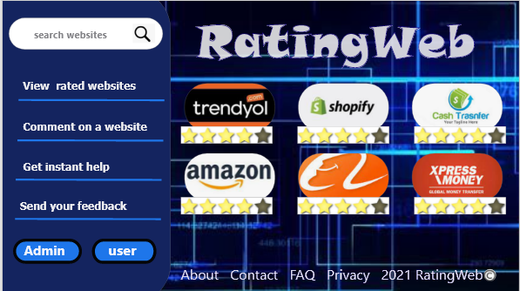



User Interface:
11

Slide 13
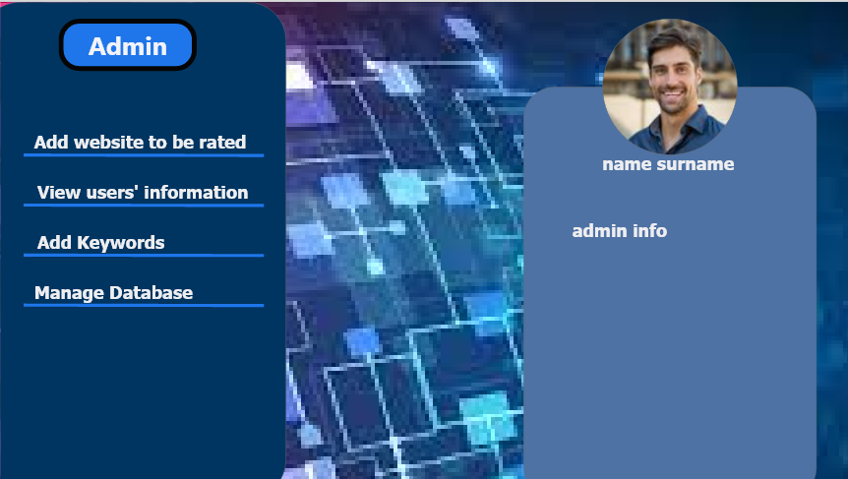


User INterface:
12

Slide 14
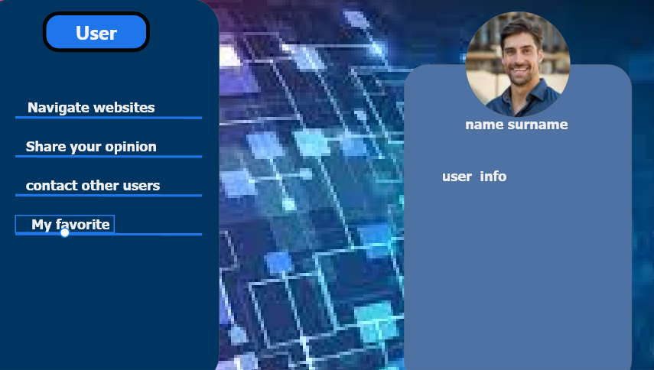


User interface:
13

Slide 15
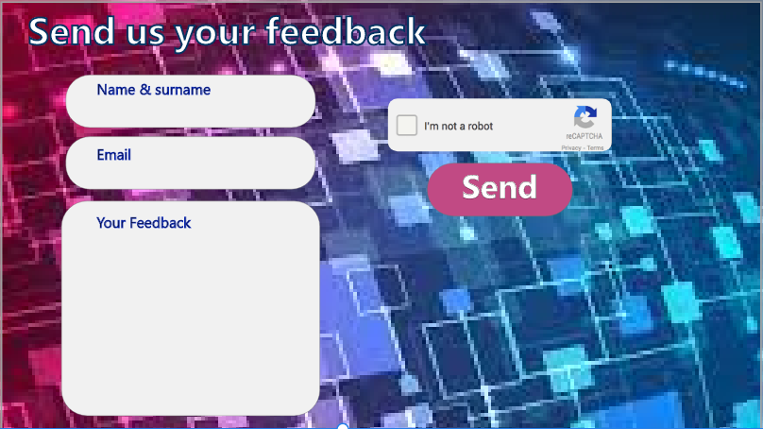



User Interface:
14

Slide 16
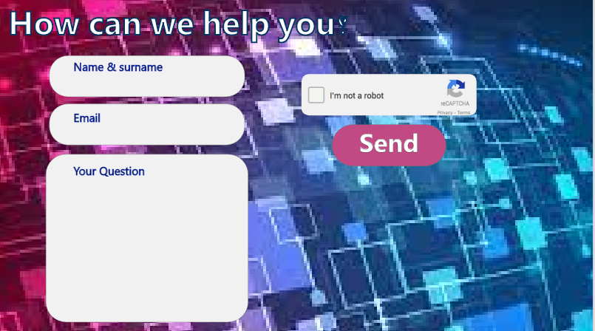


User interface:
15

Slide 17
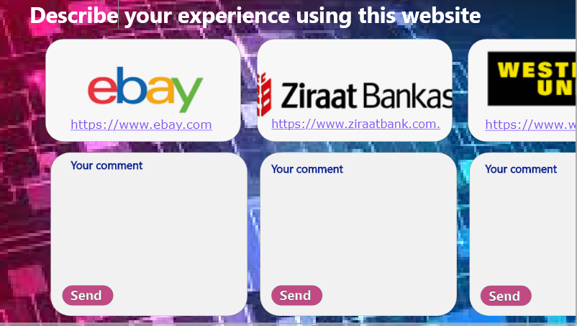


User Interface:
16

Slide 18
Nonfunctional Requirements:
Performance Requirements:
The system must have a good response time.
The load time for the User interface should take less than two seconds.
It should be able to respond to multiple numbers of people at the same time.
The log in information should be verified within five seconds.
Queries shall return results within five seconds.
17

Slide 19
Nonfunctional Requirements:
Safety Requirements:
All external communications between the system’s data server and users must be encrypted
To ensure that the system is secure, access to the various subsystems will be protected by a User log in screen and requires a User information (Mail, Name, Pass-word).
18

Slide 20
Nonfunctional Requirements:
3. Security Requirements:
Usability:
The system should have a well formed, easy and soft to use graphical User interface
The system should be User friendly
The system must be easy to learn for both novices and Users with experience from similar systems
Supportability:
The system should be easy to maintain.
In order for the system to be easy to maintain it is done with a web-based, which is easy to maintain.
Maintenance of the system should be cost efficient
19

Slide 21
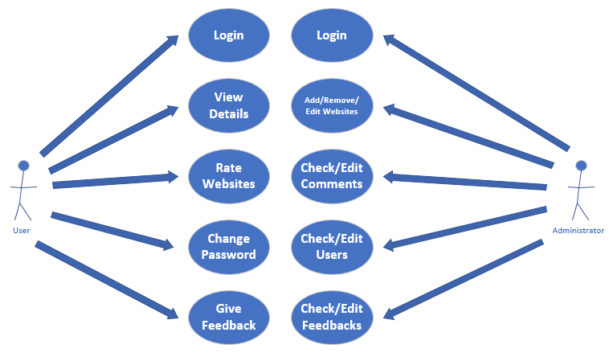
Use Case Diagram:
Change UI design
20

Slide 22
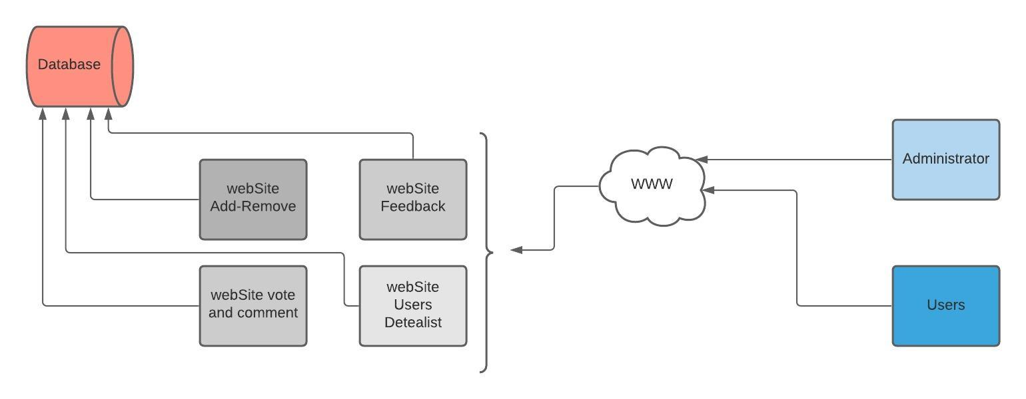
Architecture Diagram:
21

Slide 23
Thank you ☺

